Slide 1
Schedule Helper
Prepared by Mikhail Avrutskii
Teacher: Manuzina Lyubov Leonidovna
MBOU Lyceum No. 50 at DSTU
03/19/2021

Slide 2
Goals:
Create a full-fledged application that can help teachers and head teachers in creating a schedule

Slide 3
Tasks:
Learn ways to manually create a schedule, find basic filling methods
Make a list of what should be in my program and how it will interact with the user
Create the structure of the program and database
Create a program design (UI file), create a database
Create interaction between UI and database, write application logic
Successfully defend the project

Slide 4
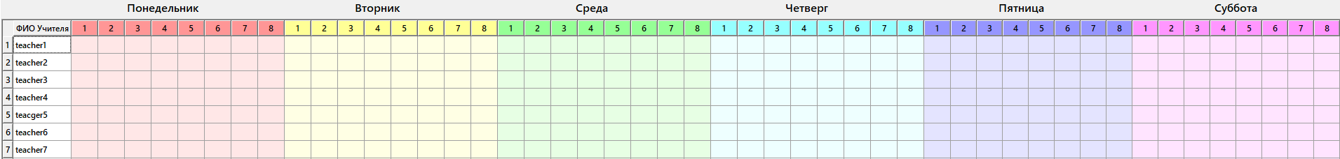
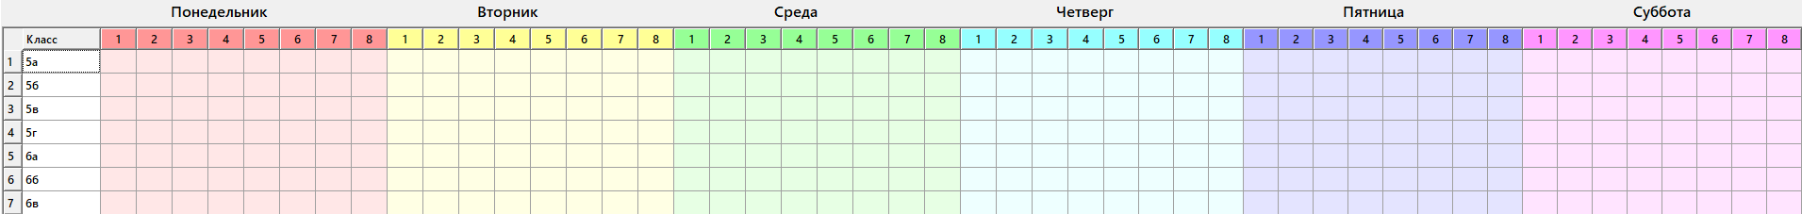
One way to manually create a schedule

Slide 5
Programming language

Slide 6
Structure
design.py – converted UI file
DataBase.db - database file
database.py - class for working with the database
main.py - main code of the program

Slide 7
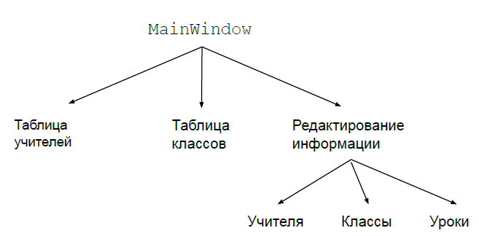
Design

Slide 8
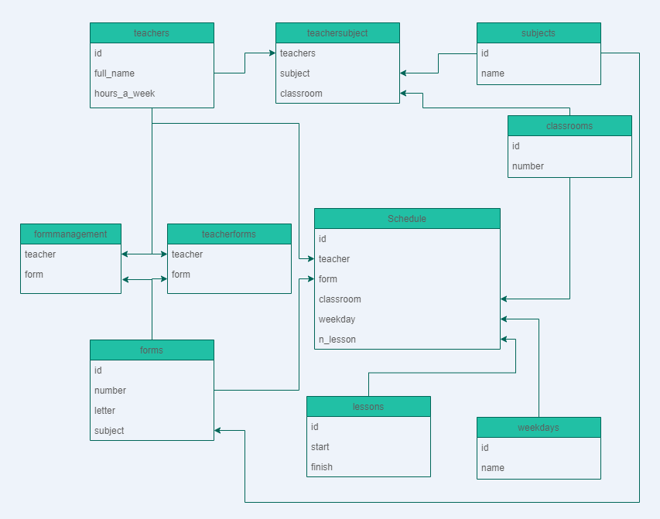
Database

Slide 9
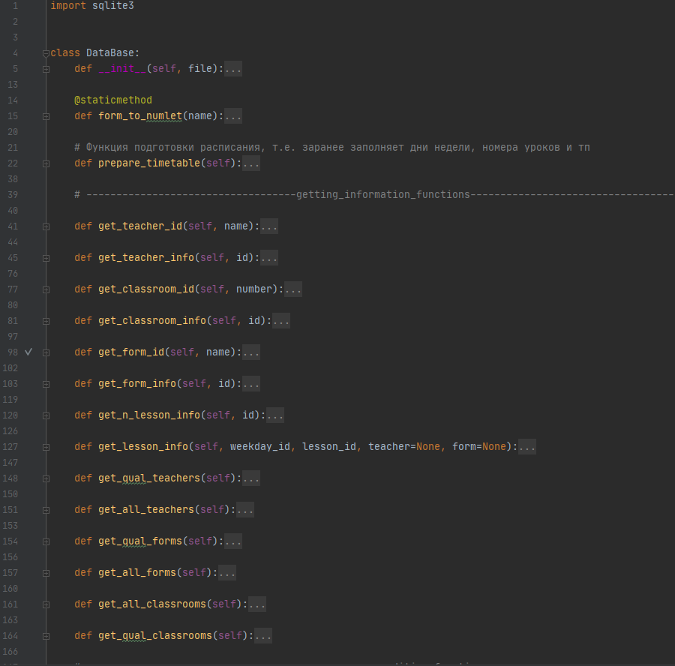
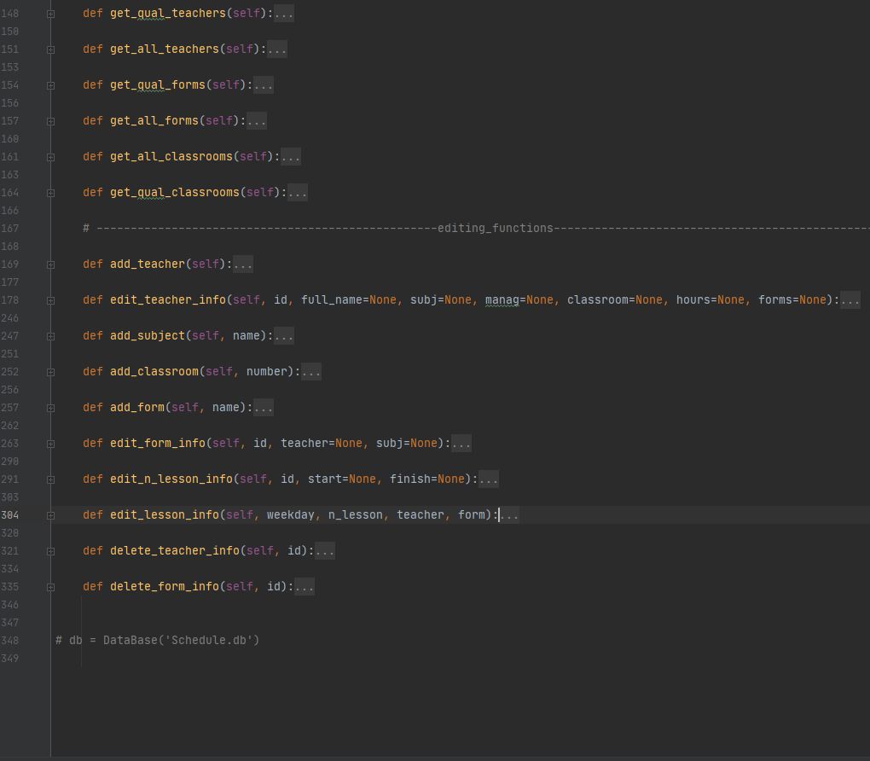
class DataBase

Slide 10
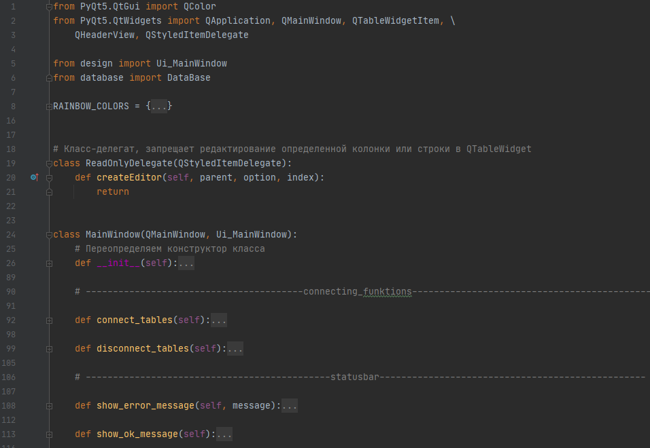
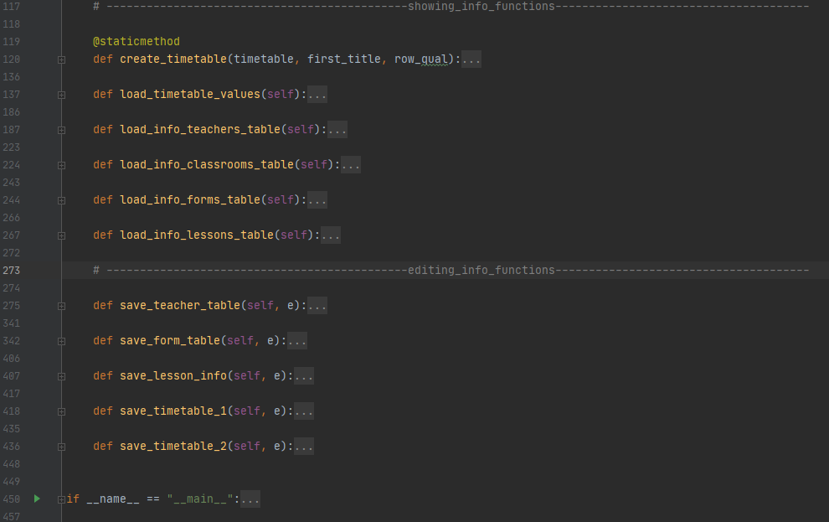
class main.py

Slide 11
Working with the application

Slide 12
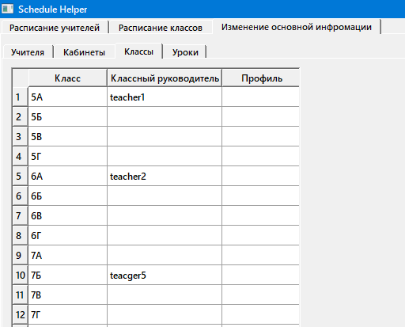
1. Fill out the classes
Notes:
For the convenience of working with the program, you should start filling out information in classes starting from the 5th
New lines are added automatically
You can only delete the last line (under revision)

Slide 13
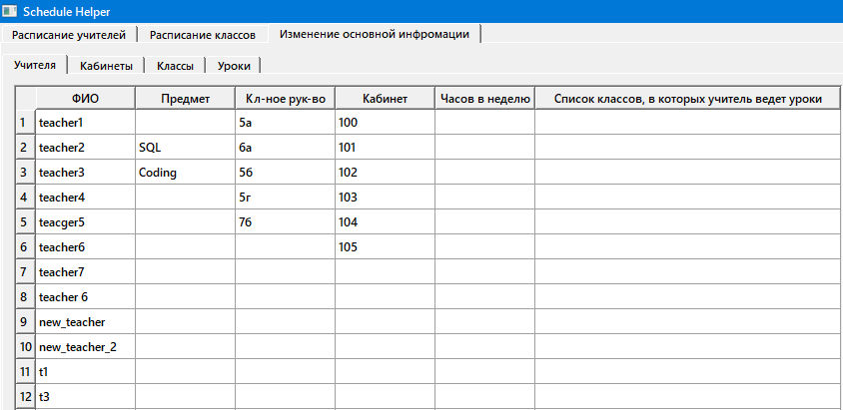
2. Fill in teachers
It is advisable to fill in all the values, but if you forgot something, you can leave it for later
After filling out, return to the classrooms and check that the classroom manual is filled out correctly.

Slide 14
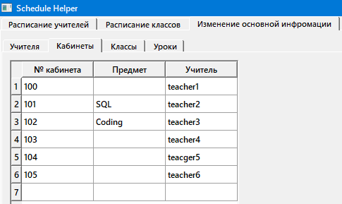
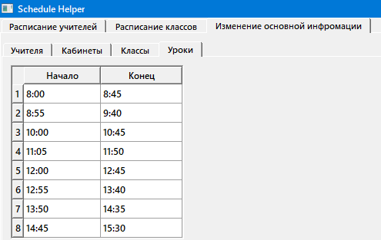
3. Complete lessons and classrooms
Offices are filled automatically based on information about the head of the office. If something is filled in incorrectly, change the information in the teachers table
The number of lessons is fixed and cannot be changed.

Slide 15
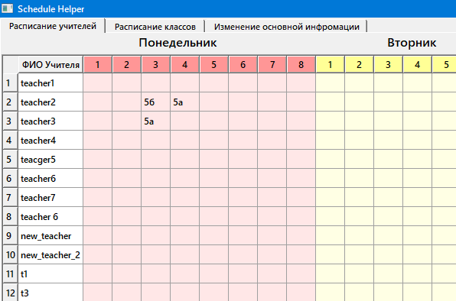
Filling out the schedule
It is more convenient for teachers to fill out the table by entering the class number and letter in the required cell, and pressing Enter
In the class schedule, the subject of the teacher who is teaching the lesson will appear in the corresponding cell.
By filling out the schedule in this way, it is very convenient to monitor the availability of windows for classes and teachers

Slide 16
Project development plan:
Make it possible to add several subjects to one teacher
Improve removal of teachers
Check all input data and, in case of error, display a message to the user
Make it possible to run a program from an exe file
Make it possible to save schedules in documents, as well as open schedules from documents
Make it possible to convert the schedule into an Excel spreadsheet for more convenient printing
Make it possible to work with different screen resolutions (currently Full HD is recommended for normal operation )

Slide 17
Conclusion
My project is not completely ready, it does not have most of the functions necessary for a full user experience. Still, I believe that in such a short time I have done quite a lot of work, gaining valuable experience working with the Python programming language and the PyQT5 and SQLite3 libraries .

Slide 18
Thank you for your attention!

